Slide 1

PANTI YATIM AL-AMANAH
Sistem Informasi
UAS PROJEK GO-LANG FUNDAMENTAL
Oleh : Krise Rohalia
01

Slide 2
Daftar Tabel
DATA KEPENGURUSAN
DATA ANAK
DATA DONATUR
DATA ADOPSI
DATA SUMBANGAN
DATA SEKOLAH
DATA RIWAYAT KESEHATAN

Slide 3
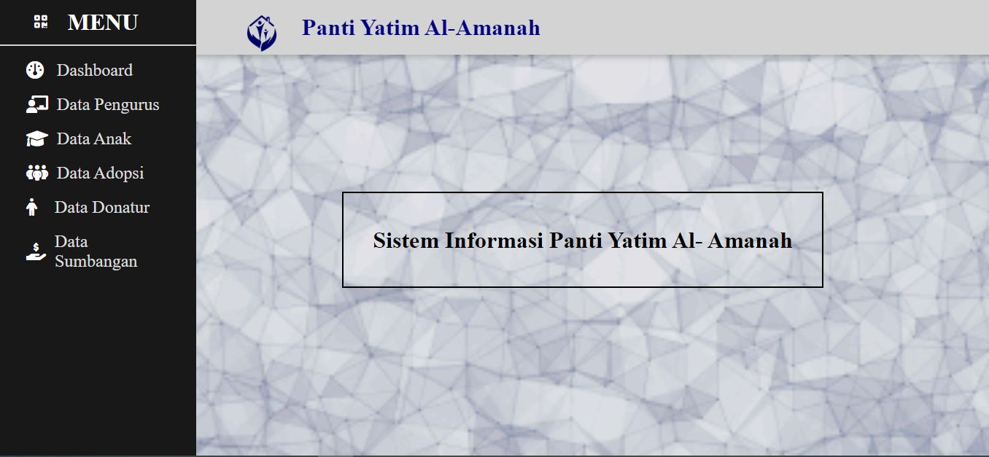
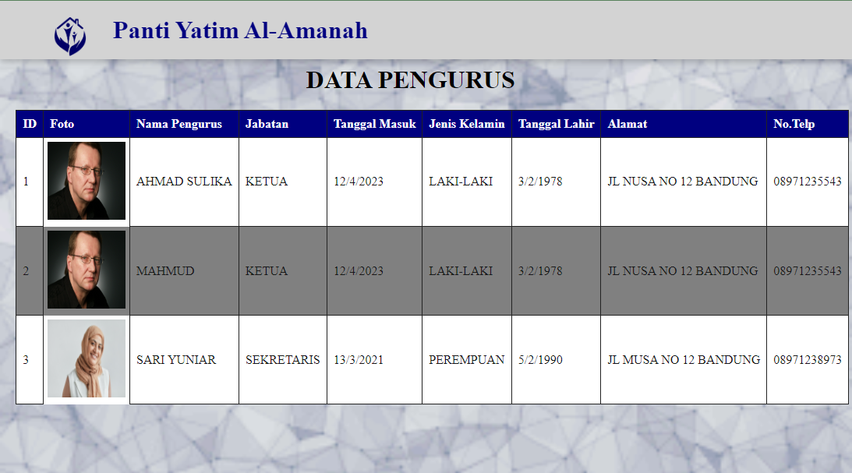
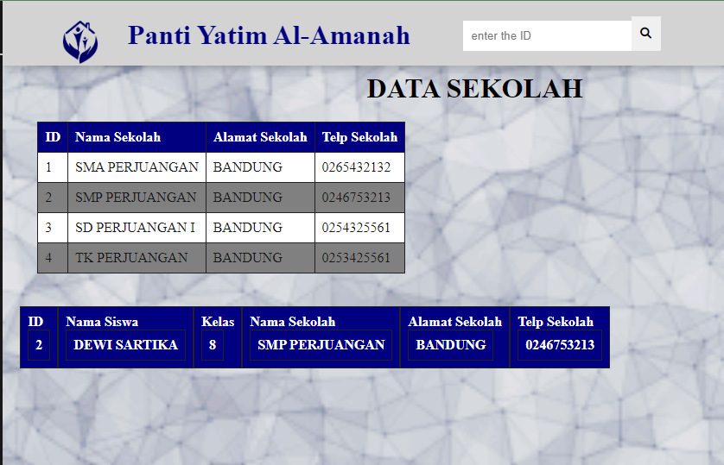
Tampilan Frond-End

Slide 4
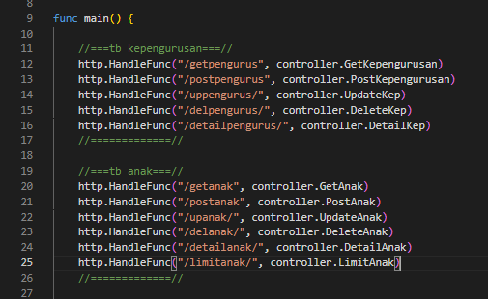
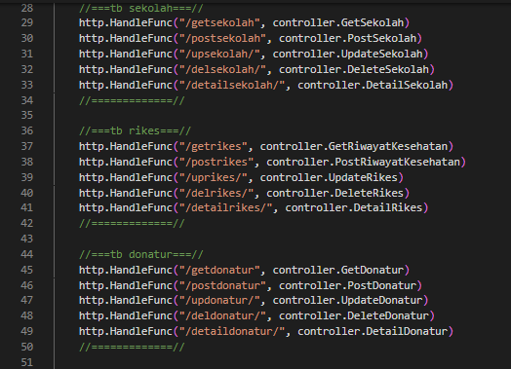
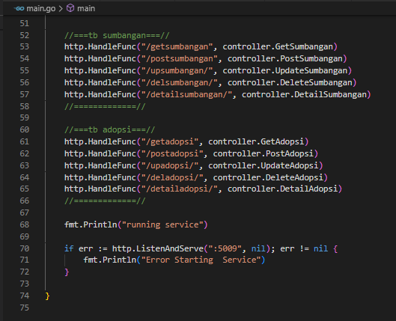
Bagian Main: Aksi Setiap Tabel

Slide 5
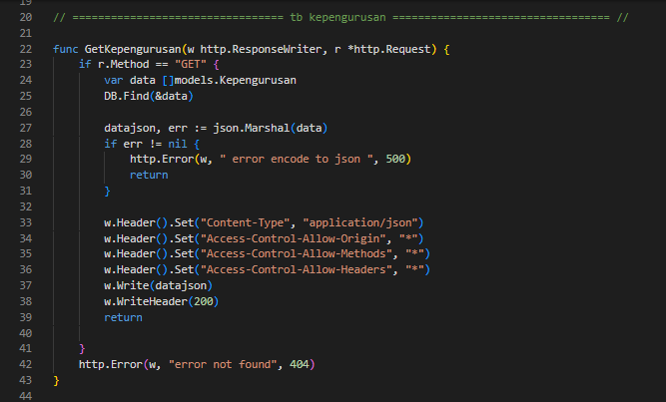
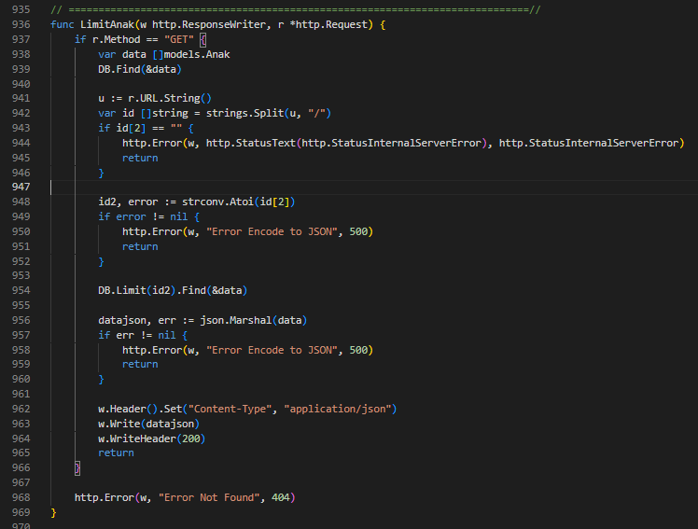
GET :
GET with Limit :

Slide 6
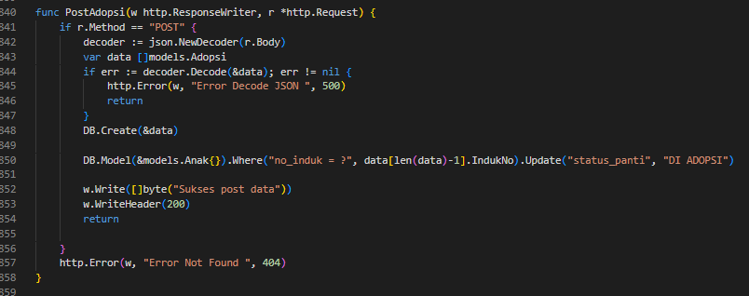
Post and Trigger (Update After Post)

Slide 7
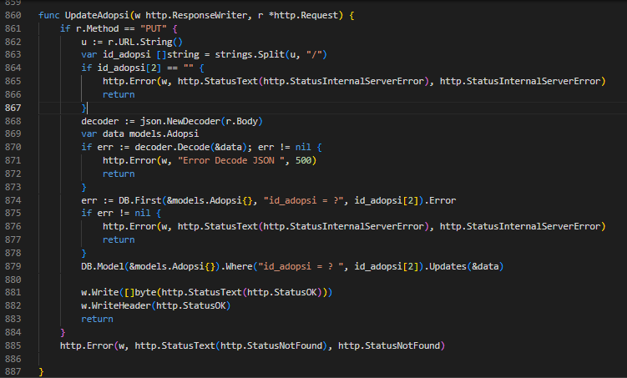
Update By :
Write an agenda here.
Write an agenda here.
Write an agenda here.

Slide 8
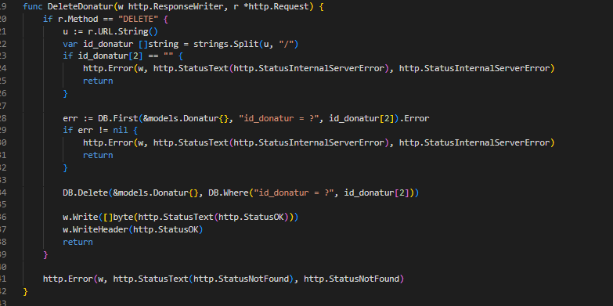
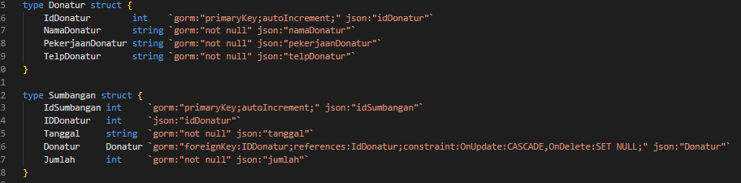
Delete with SET NULL in ForeignKey :
1

Slide 9
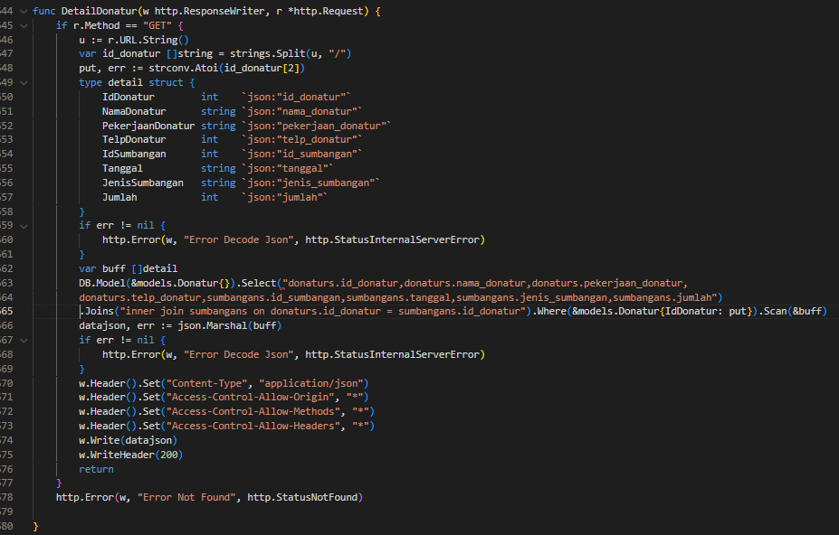

Get Detail With SELECT , JOIN and By :
Add a main point Elaborate on what you want to discuss.
Add a main point Elaborate on what you want to discuss.

Slide 10
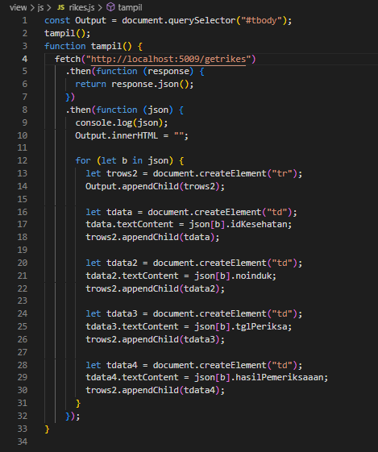
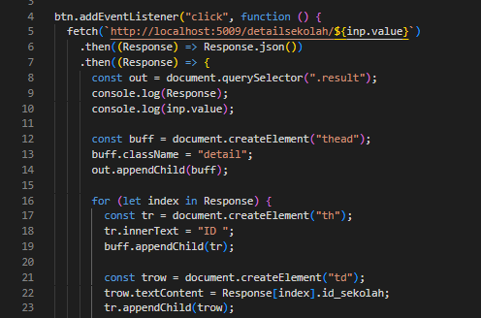
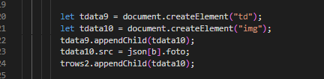
Meng- Get ke FE with JS :
Add a main point Elaborate on what you want to discuss.

Slide 11
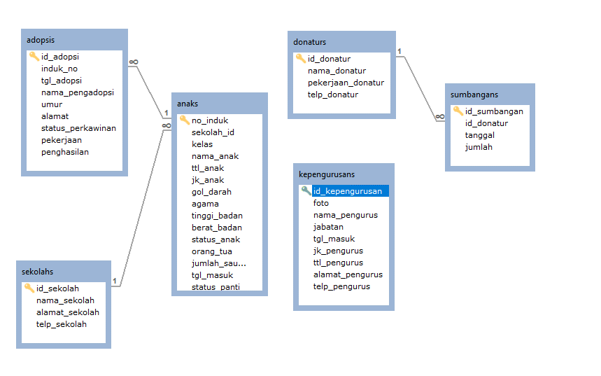
Relasi Tabel

Slide 12
Thank you!

